Slide 1


IBM Data Science Capstone Project:
Space X Falcon 9 Landing Analysis
Michelle Paniagua
28-04-2025

Slide 2

Outline
Executive Summary
Introduction
Methodology
Results
Conclusion
Appendix

Slide 3

Executive Summary
Summary of all results
Exploratory Data Analysis (EDA) results
Geospatial analytics
Interactive dashboard
Predictive analysis of classification models
Summary of methodologies
Data Collection
Exploratory Data Analysis
Interactive Visual Analytics
Predictive Analysis (Classification)

Slide 4
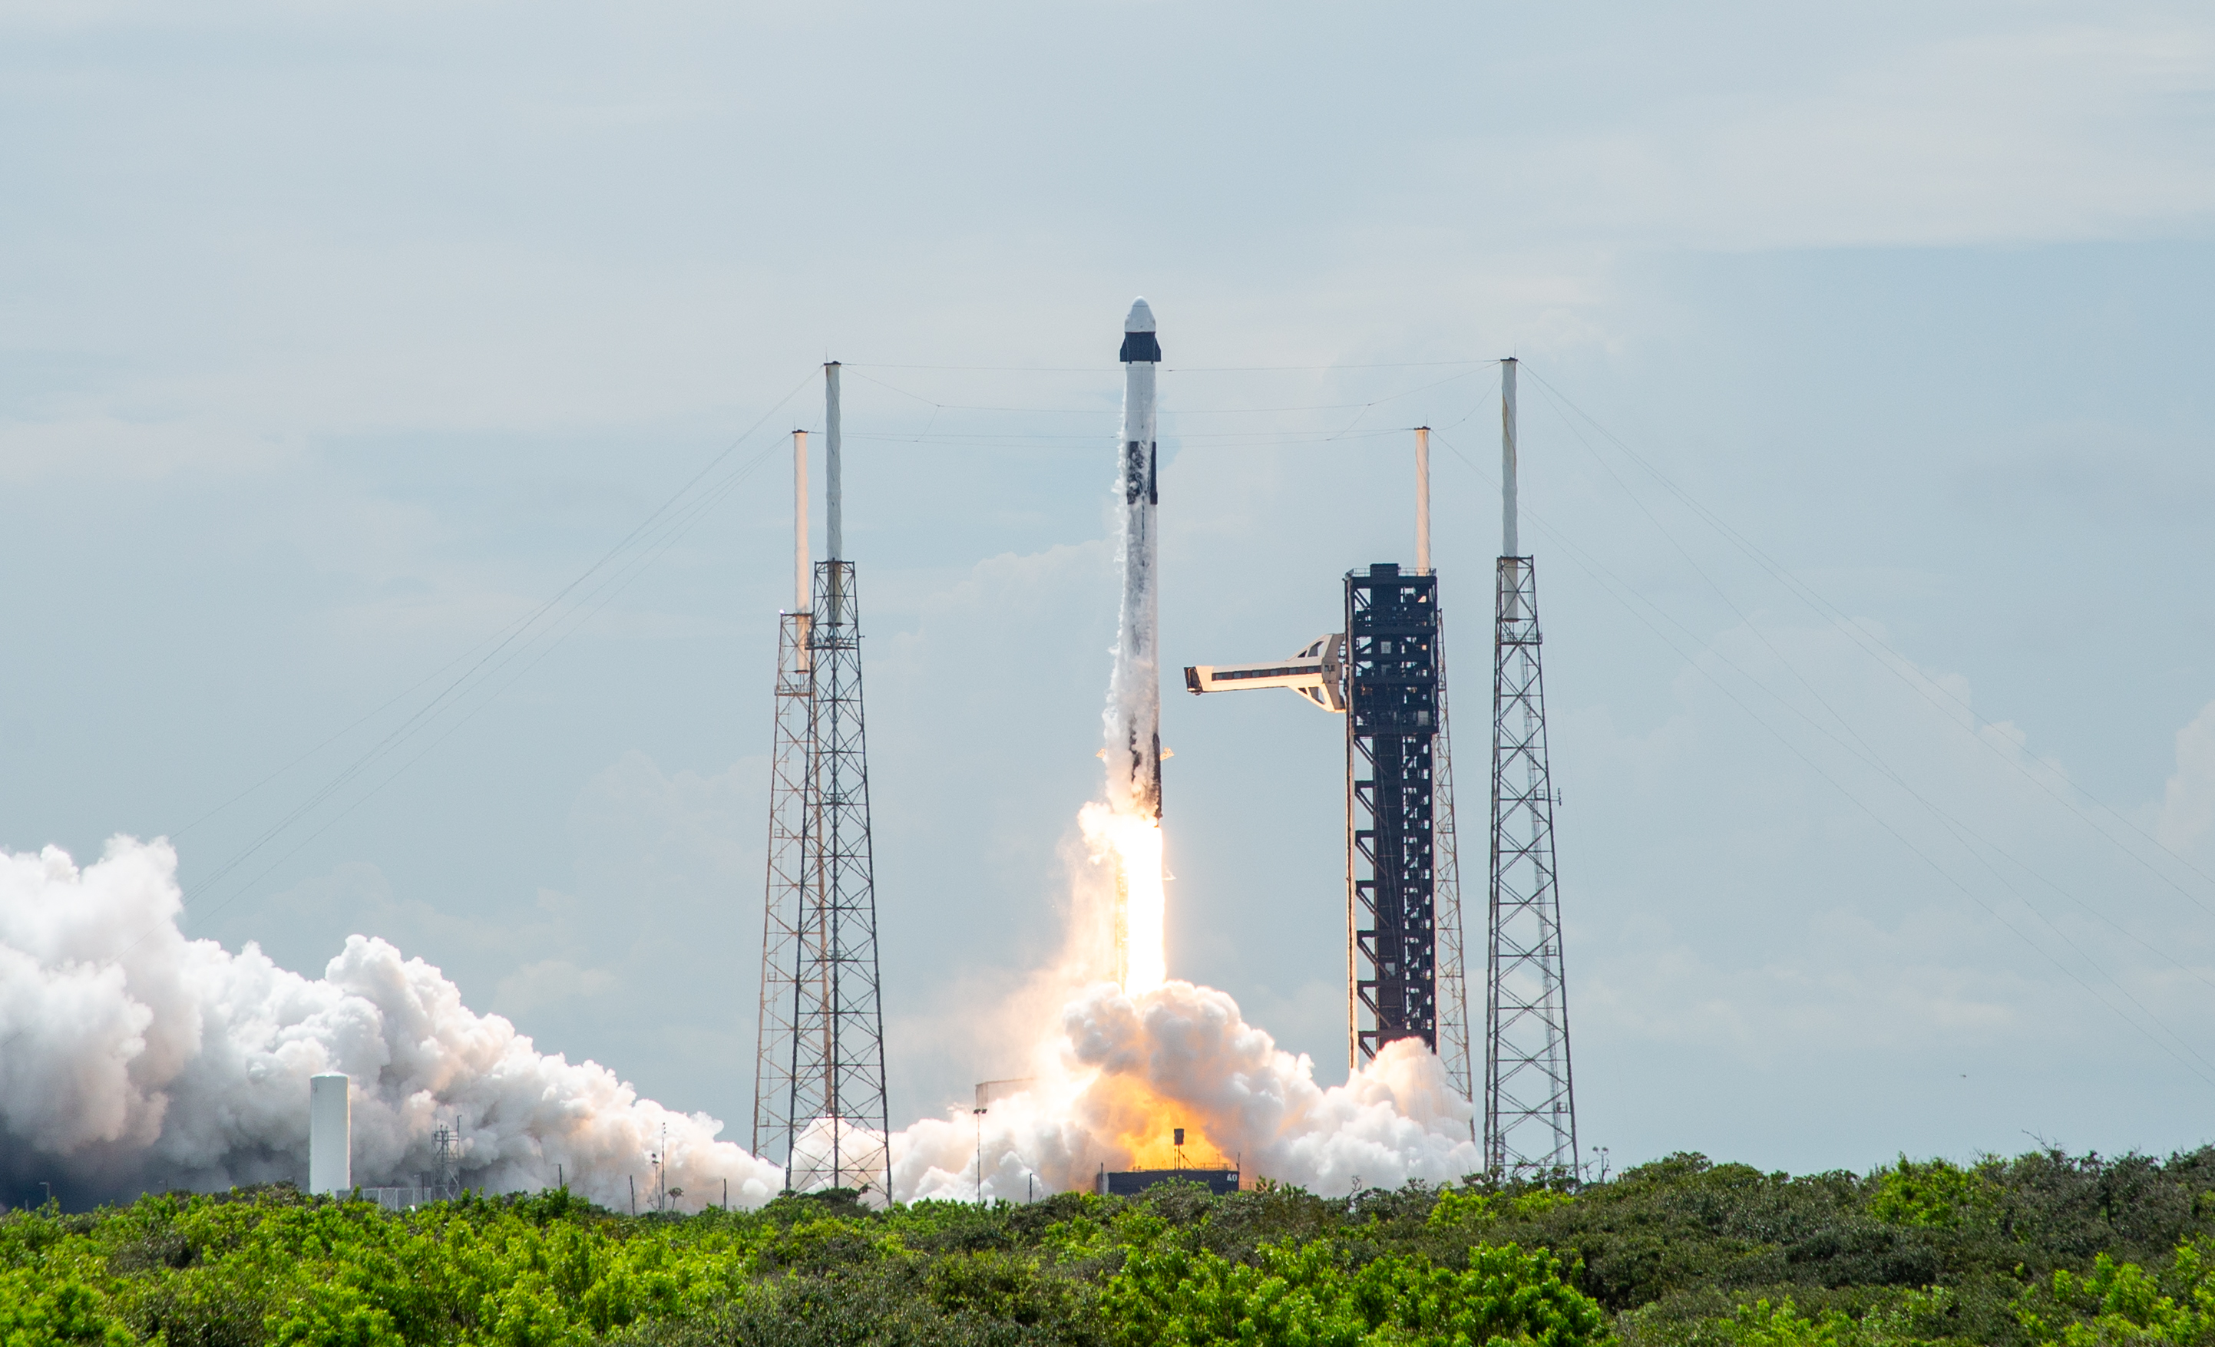
Introduction
The space missions are expensive and complex. Predicting the outcome of rocket launches can save time, money, and resources.
SpaceX launches Falcon 9 rockets for a less price. Can land and then re-use the rocket's first stage.
This project aims to predict whether the first stage will land of the Falcon 9, for this we builds a model to predict the success of rocket launches based on past data, helping improve planning and decision-making.
This prediction project will address the following problems: What variables and conditions determine the success of rocket landings? What correlation between different characteristics determines the landing success rate?

Slide 5

Section 1
Methodology

Slide 6

Methodology Summary
1. Data collection:
REST API
Web Scraping
2. Perform data wrangling
The .fillna() method was used to remove null values.
The .value_counts() method was used to determine the number of launches at each site, the number of orbits in each location, and mission results by orbit type.
A landing result label was created. A 0 indicates a failure to land, and a 1 indicates a successful landing.
3. Perform exploratory data analysis (EDA) using visualization and SQL
SQL queries are used to manipulate and evaluate the dataset.
Pandas and Matplotlib libraries are used to generate visualizations and observe relationships between variables and identify patterns.
4. Perform interactive visual analytics using Folium and Plotly Dash
A geospatial analysis was performed using Folium.
An interactive dashboard was created using Plotly Dash.
5. Perform predictive analysis using classification models
The Scikit-Learn library was used to preprocess and standardize the data, splitting the data into training and test data. Classification models were trained and hyperparameters were identified using GridSearchCV.
Confusion matrices for the classification models were plotted.
The accuracy of the classification models was evaluated.

Slide 7
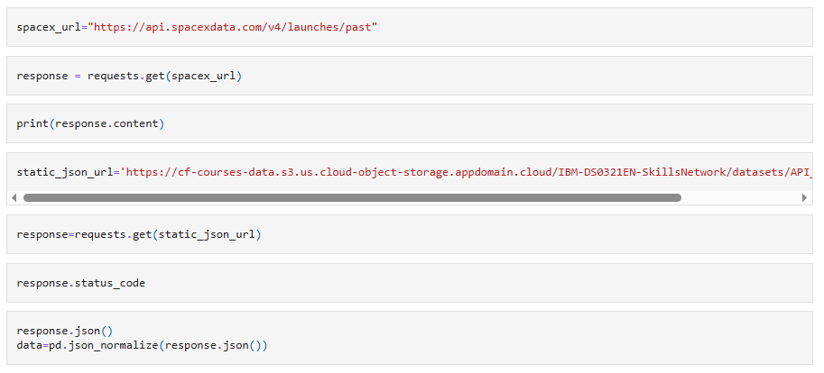
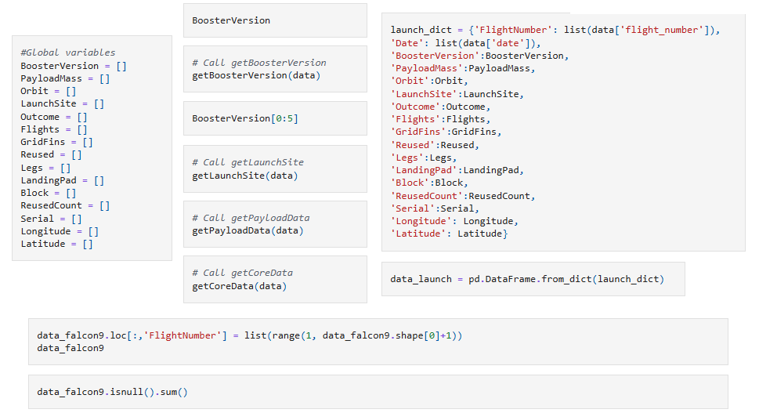
Data Collection – SpaceX API
1. Sent a GET request to the Rocket Launch REST API ➡️ Retrieved data on rockets, payloads, launch sites, and launch results.
2. Converted the API to JSON format and loaded it into a Pandas DataFrame. ➡️ To explore and manipulate the data.
3. Performed data cleaning: Managed missing values. Defined lists to organize the data. Extracted key columns such as rocket name, launch date, payload mass, etc.
4. Created the dataset: A dictionary with the extracted lists. Created a new Pandas DataFrame from the dictionary.
5. Filtered the dataset to contain only Falcon 9 launches. Reset the FlightNumber index. Replace missing PayloadMass values ​​with the average payload mass.
https://github.com/Michu-code/Class-IBM/blob/main/1.%20jupyter-labs-spacex-data-collection-api.ipynb

Slide 8
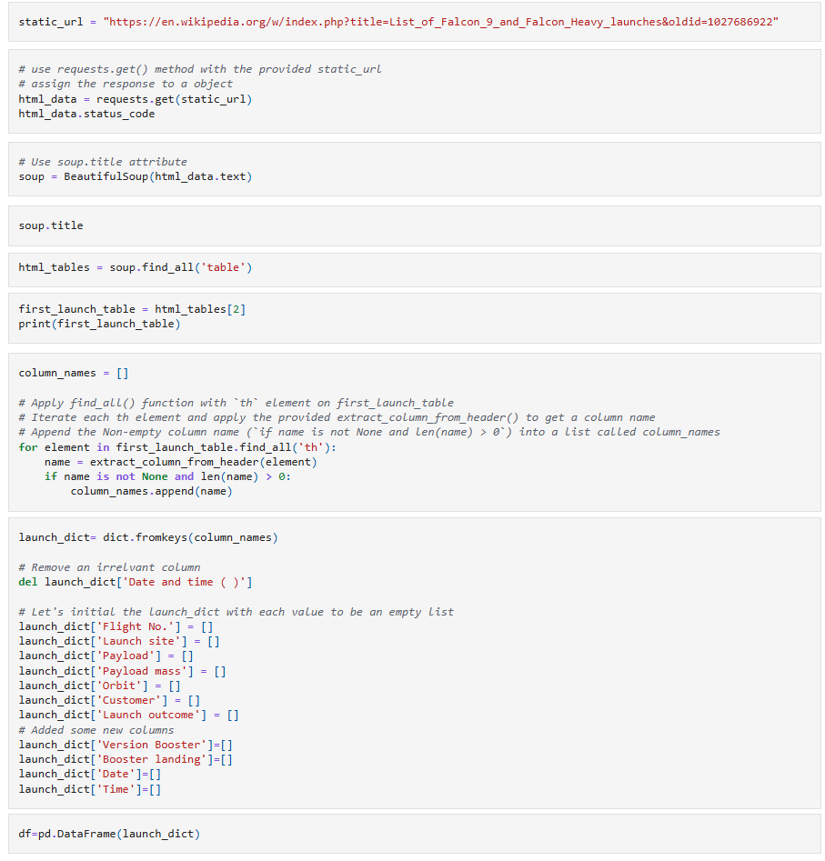
Data Collection - Web Scraping
1. A request was sent to a URL containing the launch history. ➡️ The HTML content of the page was retrieved to navigate through the HTML elements.
2. A BeautifulSoup object was created from the HTML to allow navigation through the HTML elements.
3. The HTML tables containing launch logs were searched and extracted. ➡️ The tables with launch data, payloads, and results were located.
4. The columns from the tables were extracted and a dictionary was initialized as keys ➡️ The data storage was prepared.
5. Analysis functions were used to populate the dictionary with row data from the tables. ➡️ Cases of missing data or irregular formats were handled.
6. The dictionary was converted into a DataFrame for analysis or export.
https://github.com/Michu-code/Class-IBM/blob/main/2.%20jupyter-labs-webscraping.ipynb

Slide 9
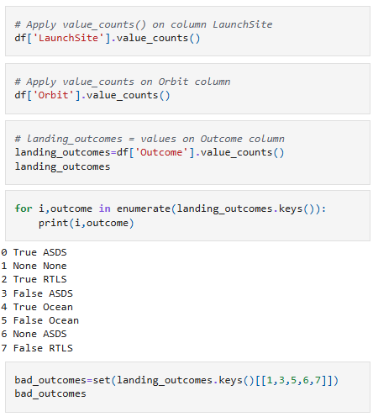
Data Wrangling
The rocket launch dataset has multiple launch sites and target orbits. The outcome of each mission is recorded in the "Outcome" column, including different types of landings, whether in the ocean, on a drone ship, or on a land platform.
Data exploration:
1.Identify missing data: Calculated missing values percentage for each column. Found missing values mainly in the LandingPad column.
2. Data type: Identified categorical and numerical columns (like FlightNumber as integer, orbit as object).
3. Analyze launch sites: Used .value_counts() to find the number of launches per site.
4. Analyze orbit types: Used .value_counts() to determine the distribution of orbit types.
5. Analyze mission outcomes: Used .value_counts() to explore the different landing outcomes.
https://github.com/Michu-code/Class-IBM/blob/main/3.%20labs-jupyter-spacex-Data%20wrangling.ipynb

Slide 10
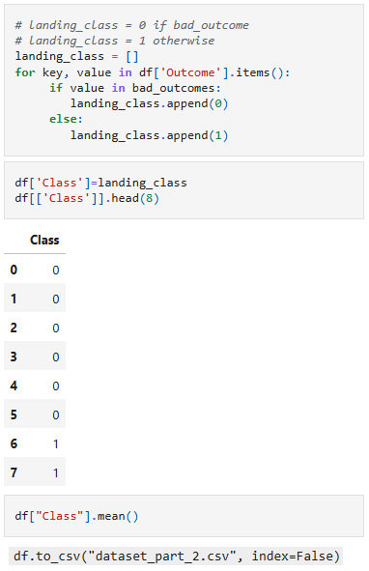
Data Wrangling
Data Labeling:
6. Create landing outcome labels: Defined unsuccessful outcomes (bad_outcomes set) Created a class column: 1 = successful landing 0 = failed landing
7. Calculate success rate: Computed the mean of the Class column to find overall landing success rate.
8. Export data: Saved the cleaned dataset as dataset_part_2.csv.
Landing Outcome Details: True Ocean – Successful landing in the ocean False Ocean – Failed landing in the ocean True RTLS – Successful landing on a ground pad False RTLS – Failed landing on a ground pad True ASDS – Successful landing on a drone ship False ASDS – Failed landing on a drone ship None ASDS / None None – No landing attempt or missing data
https://github.com/Michu-code/Class-IBM/blob/main/3.%20labs-jupyter-spacex-Data%20wrangling.ipynb

Slide 11



EDA with Data Visualization
Scatter Plot
Explore relationships between two numerical variables.
Identify trends, patterns, or clusters in the data.
Bar chart
Compare a numerical value across categories.
Visualize differences in success rates among different orbit types.
Line Chart
Show trends over time.
Track the progress or change of a metric across years.
Notes:
https://github.com/Michu-code/Class-IBM/blob/main/5.%20edadataviz.ipynb

Slide 12
EDA with SQL
This process involves using SQL queries to explore and retrieve specific information from a dataset related to space missions. These queries include:
1. Listing the names of launch sites across missions.
2. Displaying five records where launch sites begin with "CCA."
3. Calculating the total payload mass carried by rockets launched by NASA (CRS).
4. Obtaining the average payload weight of the F9 v1.1 booster.
5. Finding the date of the first successful landing on land.
6. Identifying the names of successful boosters on unmanned spacecraft that carried payloads between 4,000 and 6,000 kg.
7. Counting the total number of successful and unsuccessful missions.
8. Determining which booster versions carried the largest payloads.
9. List the failed unmanned spacecraft landings in 2015, including booster versions and launch sites.
10. Classify the landings (as "Failure" or "Success") over a date range from June 4, 2010, to June 4, 2013, in descending order.
https://github.com/Michu-code/Class-IBM/blob/main/4.%20jupyter-labs-eda-sql-coursera_sqllite.ipynb

Slide 13
Build an Interactive Map with Folium
This brief explains how different objects were created and added to an interactive map to visualize launch data.
All launch sites were marked on the map using a Folium Map object.
For each site, a circle and a marker were added to identify its location.
To display successful and failed launches at each site, the events were grouped together, as many shared the same coordinates.
Before grouping, each marker was assigned a color: green for successful launches (class = 1) and red for failed launches (class = 0).
A MarkerCluster was used to group the launches, adding a marker for each with a text icon indicating the distance, whose color matched the launch status.
To analyze the proximity of the launch sites, the distances between points were calculated using their latitude and longitude coordinates.
Markers were created to show these distances and lines were drawn (using folium.PolyLine) to visualize the connections between sites and their proximities on the map.
https://github.com/Michu-code/Class-IBM/blob/main/6.%20lab_jupyter_launch_site_location.ipynb

Slide 14
Build a Dashboard with Plotly Dash
Two types of charts were incorporated into a Plotly Dash panel to facilitate interactive data visualization.
First, the corresponding libraries were imported to develop the web application in Python. These include dash_html_components, dash_core_components, dash.dependencies, and plotly.express.
Pie chart
Using px.pie(), which illustrates the number of successful launches at each site, allowing us to identify which are the most successful.
Additionally, dcc.Dropdown() was added to allow filtering the chart using a dropdown menu and thus analyze the success or failure rate for a specific site.
Scatter chart
Using px.scatter(), which shows the relationship between the launch result (success or failure) and the payload mass in kilograms.
Finally, RangeSlider() was used to provide a slider bar and provide an interactive chart. It can also be filtered by mass ranges and different propellant types.
https://github.com/Michu-code/Class-IBM/blob/main/7.%20spacex_app.py

Slide 15
Predictive Analysis (Classification)
To develop and find the best-performing classification model, we followed a structured process that included several steps:
Model development
Next, we selected different machine learning algorithms suitable for our problem. For each, we created a GridSearchCV object along with a dictionary of hyperparameters to tune. We trained the models using the training data and tuned the hyperparameters to optimize their performance.
Model evaluation
To evaluate each model, we reviewed the best hyperparameters (best_params_) and accuracy metrics (score and best_score). We also graphed and analyzed the confusion matrix to better understand how they performed.
Data preparation
First, we loaded the data using Numpy and Pandas, performed the necessary transformations such as standardization and preprocessing, and then split the dataset into training and test data using train_test_split().
Selecting the best model
Finally, we compared the accuracy scores of all the tested algorithms. The model with the highest score was considered the best performer.
This process allowed us not only to create different models but also to systematically evaluate them and select the one that best suited our data and objectives.
https://github.com/Michu-code/Class-IBM/blob/main/8.%20Machine%20Learning%20Prediction.ipynb

Slide 16
Exploratory data analysis results
Interactive analytics demo in screenshots
Predictive analysis results
Results

Slide 17
Section 2
Exploratory data analysis with visualization

Slide 18
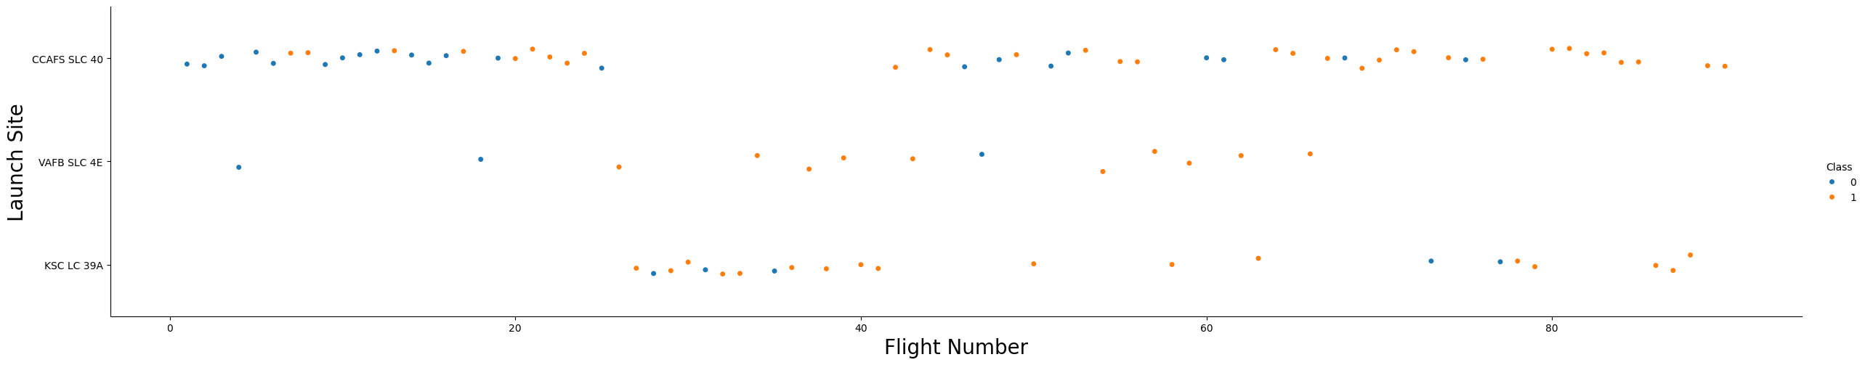
Flight Number vs. Launch Site
Scatter Plot:
Show the relationship between flight number and launch success for different sites
As the number of flights increases, the success rate at a launch site also increases.
Most early flights (Flight Number < 30) were launched from CCAFS SLC 40 and generally had lower success rates.
VAFB SLC 4E shows a similar trend, with early launches being less successful.
KSC LC 39A did not have early flights; launches from this site were generally more successful from the start.
Above a flight number of around 30, there are significantly more successful landings (Class = 1).
https://github.com/Michu-code/Class-IBM/blob/main/5.%20edadataviz.ipynb

Slide 19
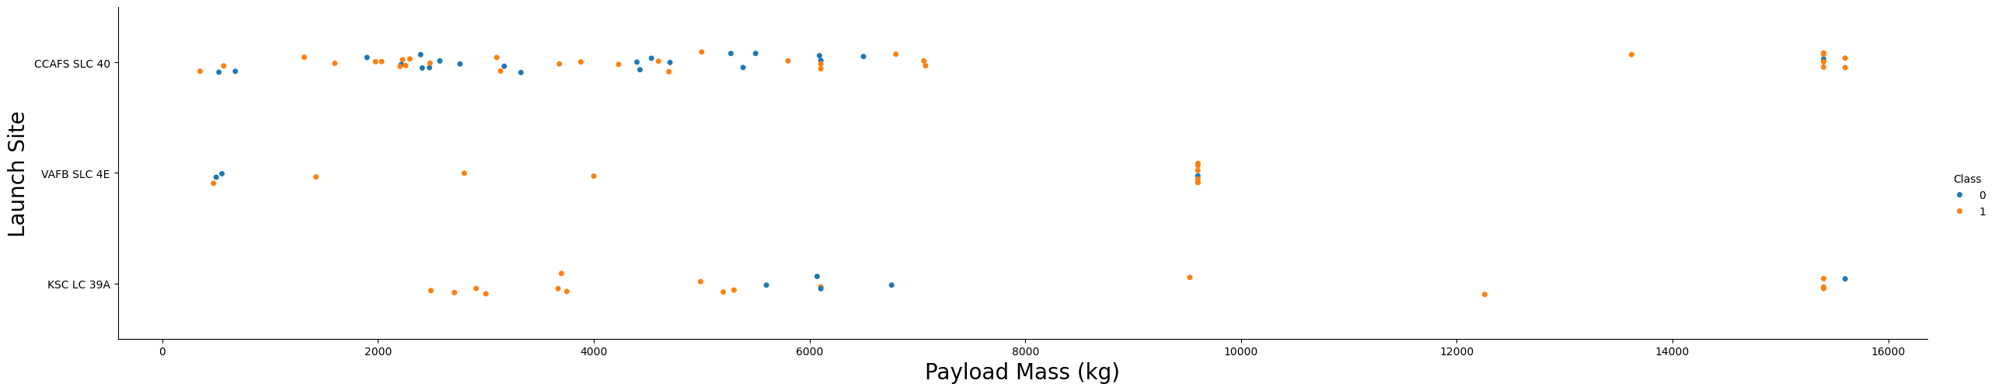
Payload vs. Launch Site
Scatter Plot
Heavier payloads (above 7000 kg) are rare, and when present, they generally show higher success rates.
There is no clear, consistent correlation between payload mass and success rate at any specific site.
CCAFS SLC 40 tends to have lighter payloads compared to other sites, although there are some heavier outliers.
Overall, higher payloads at CCAFS SLC 40 appear to be associated with better landing success.
https://github.com/Michu-code/Class-IBM/blob/main/5.%20edadataviz.ipynb

Slide 20
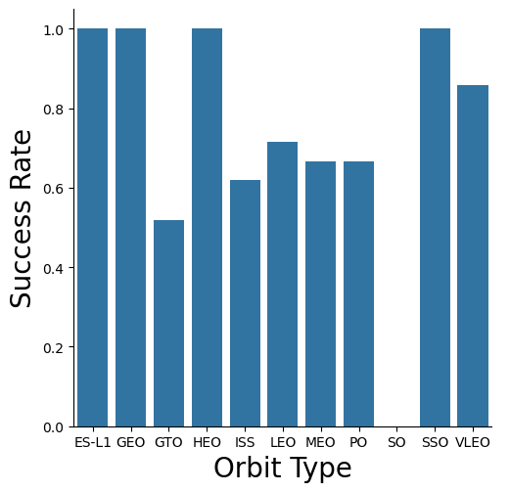
Success Rate vs. Orbit Type
Bar Chart
Compares the success rates across different orbit types.
Certain orbits like ES-L1, GEO, HEO, and SSO achieved a 100% success rate.
VLEO also showed a strong success rate.
The SO (Heliocentric Orbit) had the lowest success rate, with 0% success.
This suggests that mission target orbit plays a critical role in determining landing success.
https://github.com/Michu-code/Class-IBM/blob/main/5.%20edadataviz.ipynb

Slide 21
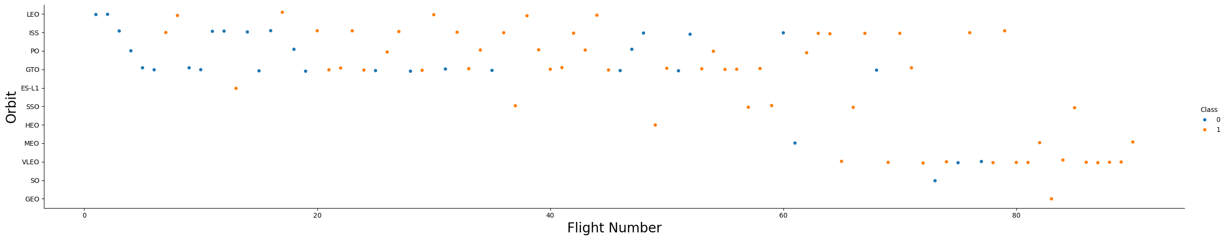
Flight Number vs. Orbit Type
Scatter Plot
Explores how launch experience (flight number) affects success across different orbit types.
Orbits like GEO, HEO, and ES-L1 had 100% success rates, but with only one launch each.
The SSO orbit shows a more impressive trend: multiple flights with consistent success.
LEO orbits show a clear pattern where more flights lead to higher success rates.
For GTO orbits, no strong relationship between flight number and success was observed.
https://github.com/Michu-code/Class-IBM/blob/main/5.%20edadataviz.ipynb

Slide 22
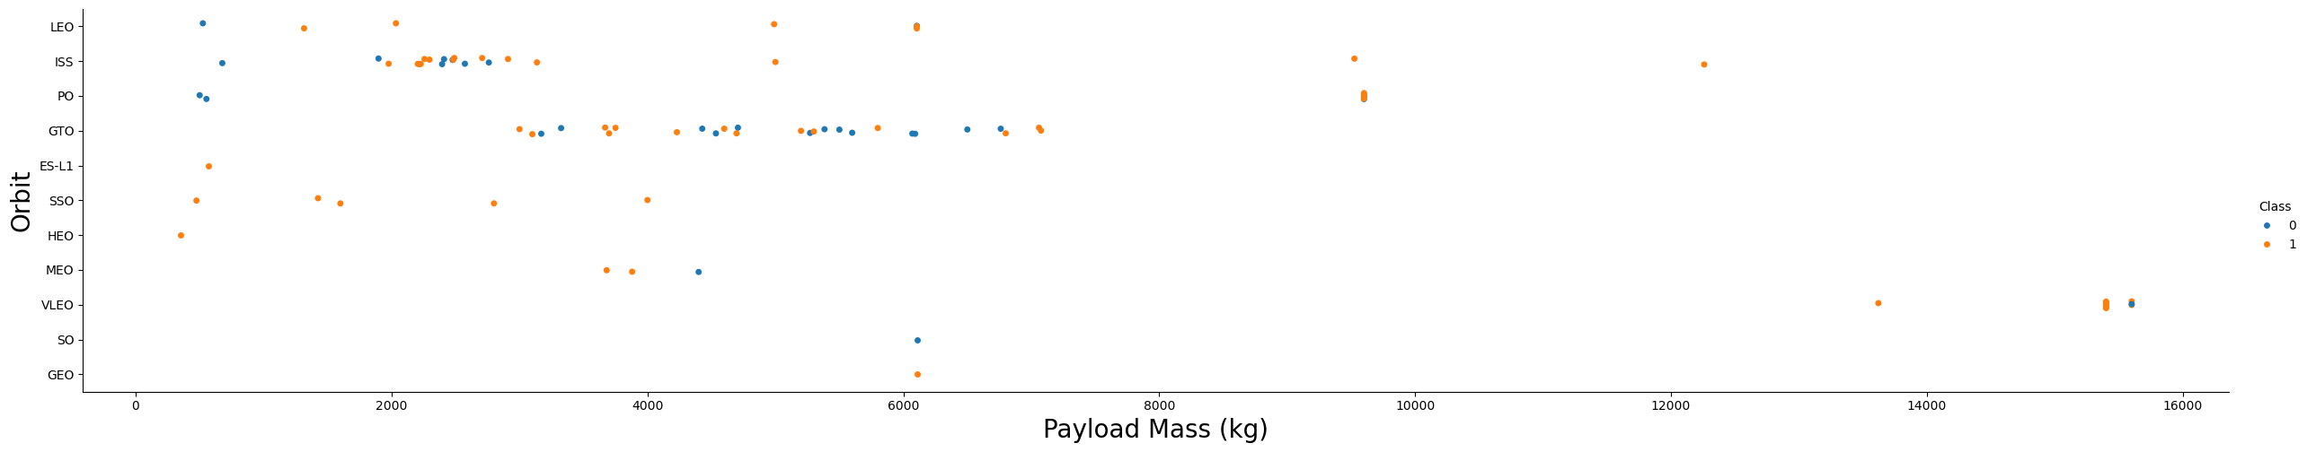
Payload vs. Orbit Type
Scatter Plot
Purpose: Investigates the link between payload mass and orbit type success.
Heavy payloads tend to be launched into PO, ISS, and LEO orbits.
In these orbits, higher payloads are associated with greater landing success.
For GTO orbits, the relationship between payload mass and success rate is unclear.
VLEO launches also involve heavier payloads, which aligns with mission needs.
https://github.com/Michu-code/Class-IBM/blob/main/5.%20edadataviz.ipynb

Slide 23
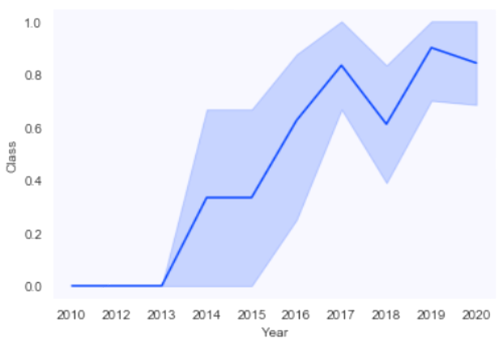
Launch Success Yearly Trend
Line Chart
Tracks the yearly trend of landing success over time.
From 2010 to 2013, no landings were successful (success rate = 0%).
After 2013, the success rate steadily increased, despite minor dips in 2018 and 2020.
After 2016, there was consistently a greater than 50% chance of success.
The continuous improvement reflects SpaceX’s learning curve and technological advancements.
https://github.com/Michu-code/Class-IBM/blob/main/5.%20edadataviz.ipynb

Slide 24
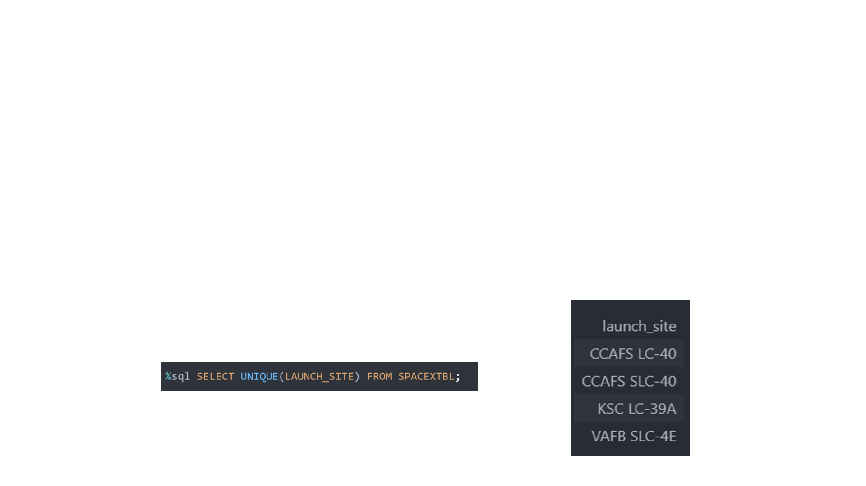
All Launch Site Names
To find the names of the launch sites, the DISTINCT keyword is used and it returns the values ​​from the LAUNCH_SITE column of the SPACEXTBL table.

Slide 25
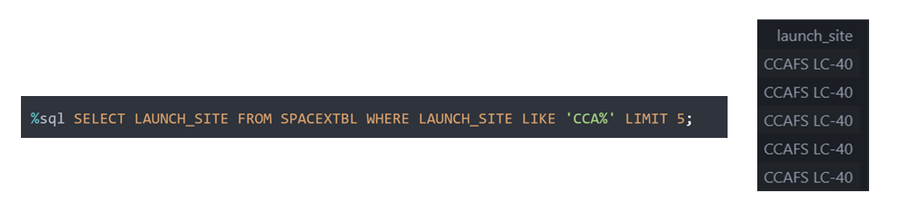
Launch Site Names Begin with 'CCA'
We used a SQL query to find 5 records where the launch site name begins with 'CCA'.
The LIKE 'CCA%' wildcard was used to filter launch sites starting with those letters, and LIMIT 5 was applied to retrieve only the first 5 matching records.

Slide 26
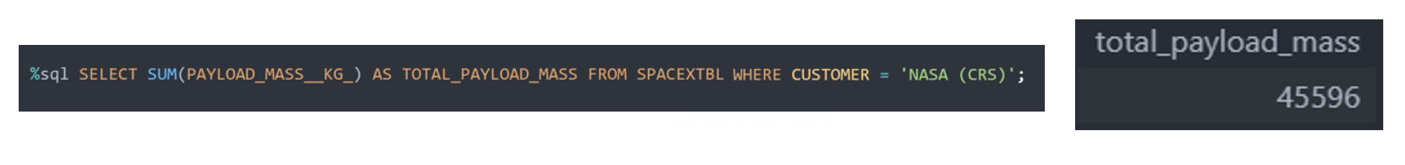
Total Payload Mass
We calculated the total payload carried by boosters from NASA.
Using the SUM keyword on the payload mass column, filtered for NASA (CRS) missions, we found the total payload to be 45596.

Slide 27
Average Payload Mass by F9 v1.1
We calculated the average payload mass carried by the F9 v1.1 booster version.
Using the AVG keyword on the payload mass column and filtering by booster version, the average payload mass was found to be approximately 2928.4

Slide 28
First Successful Ground Landing Date
We determined the date of the first successful landing on a ground pad.
Using the MIN keyword on the date column, filtered for successful ground pad outcomes, the first successful landing was observed on December 22, 2015.

Slide 29
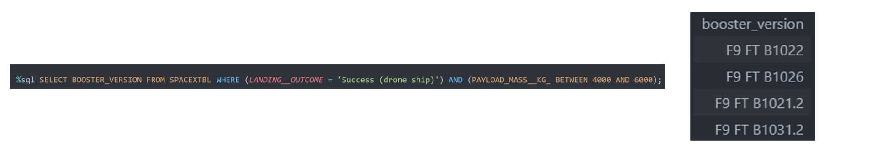
Successful Drone Ship Landing with Payload between 4000 and 6000
We filtered the data to find boosters that successfully landed on a drone ship with payload mass between 4000 kg and 6000 kg.
The WHERE clause with an AND condition and BETWEEN was used to select only the boosters meeting both criteria.

Slide 30
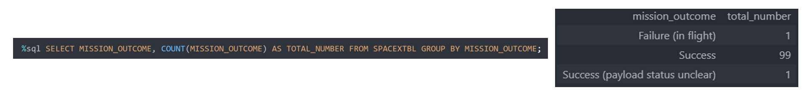
Total Number of Successful and Failure Mission Outcomes
We calculated the total number of successful and failed mission outcomes.
The COUNT keyword was used to tally outcomes, and the GROUP BY keyword helped group results by mission success or failure categories.

Slide 31
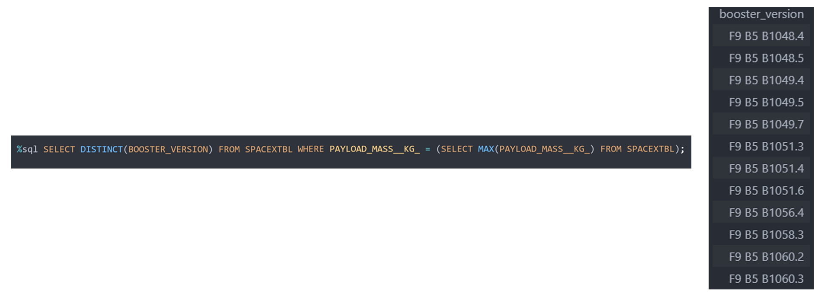
Boosters Carried Maximum Payload
We listed the boosters that carried the maximum payload mass.
A subquery using the MAX() function was applied in the WHERE clause, and the DISTINCT keyword was used to retrieve unique booster versions that achieved this.

Slide 32
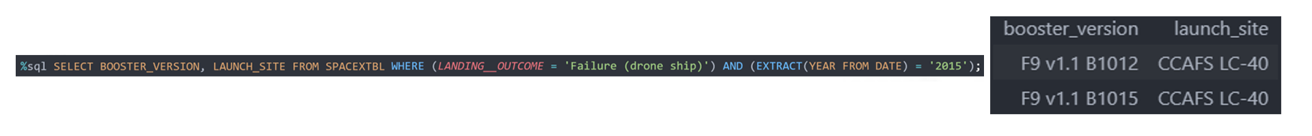
2015 Launch Records
We retrieved failed landing outcomes on drone ships for the year 2015.
A combination of WHERE, LIKE, AND, and BETWEEN clauses was used to filter for drone ship failures during that specific year.

Slide 33
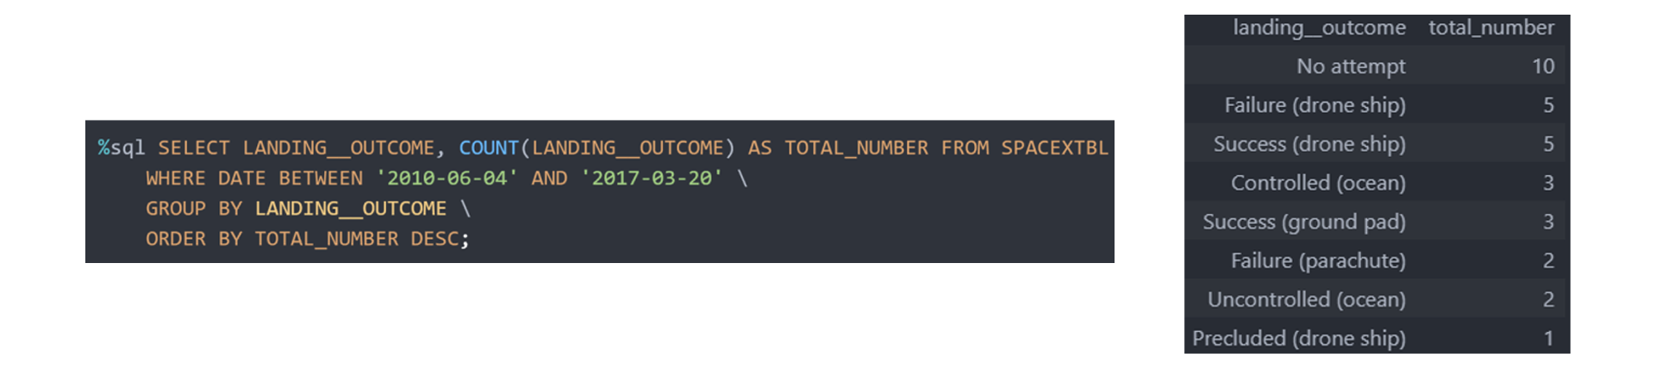
Rank Landing Outcomes Between 2010-06-04 and 2017-03-20
We ranked the number of different landing outcomes between 2010-06-04 and 2017-03-20.
Using WHERE with BETWEEN, we filtered the timeframe, then applied GROUP BY to group the outcomes and ORDER BY DESC to rank them from most to least frequent.

Slide 34

Section 3
Launch sites proximity analysis: Folium interactive map

Slide 35
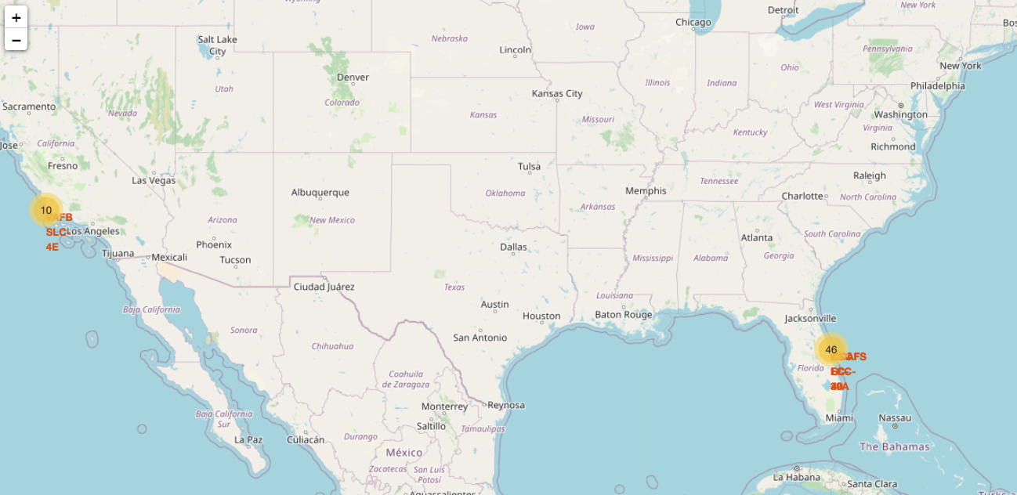
Folium map with launch sites’ location markers on a global map
This is the map of SpaceX launch sites are on coasts of the United States of America. The markers is in Florida and California

Slide 36
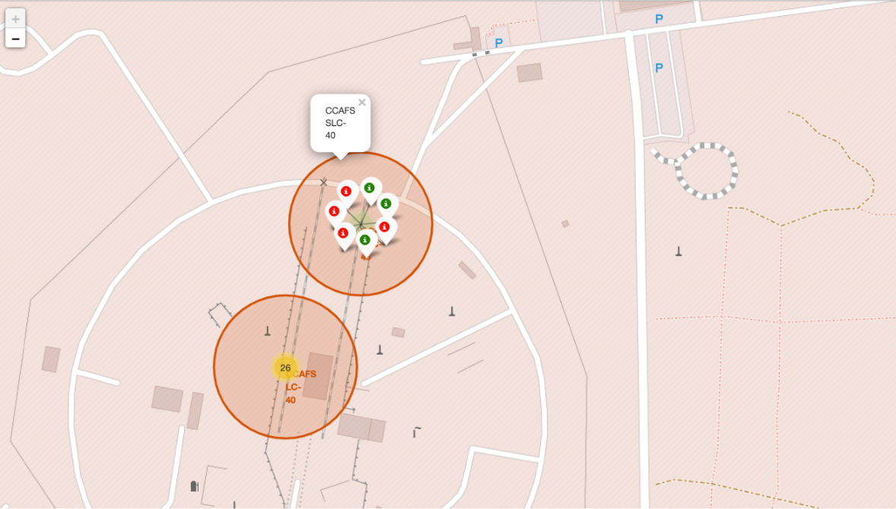
Launch sites with color labels
Launches, on this almost CCAFS SLC-40, have been marked with green icons for successful launches and red for failed ones.

Slide 37
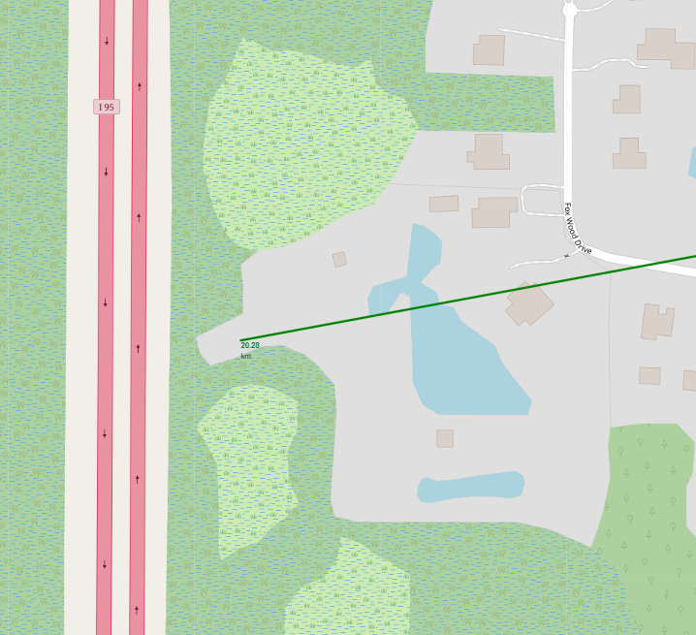
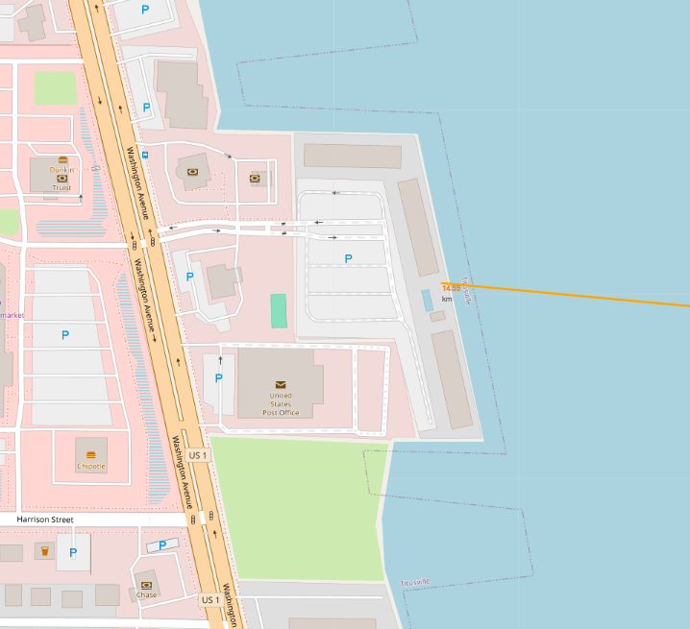
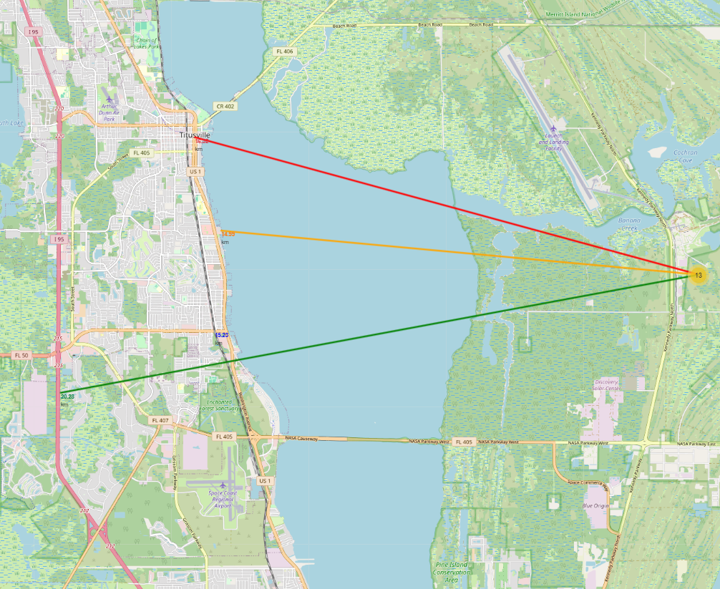
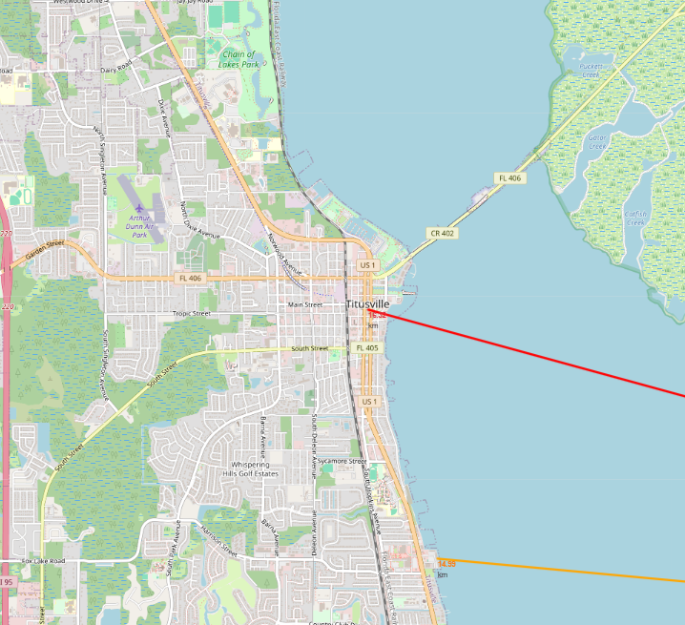
Proximity of launch point to other places of interest
Using the Florida launch site, we can understand the location of the launch sites.
Launch sites near highways: 20.28 km
Launch sites near cities: 16.32 km from Titusville, Florida
Launch sites near the coast: 14.99 km

Slide 38

Section 4
Interactive dashboard with Plotly Dash

Slide 39
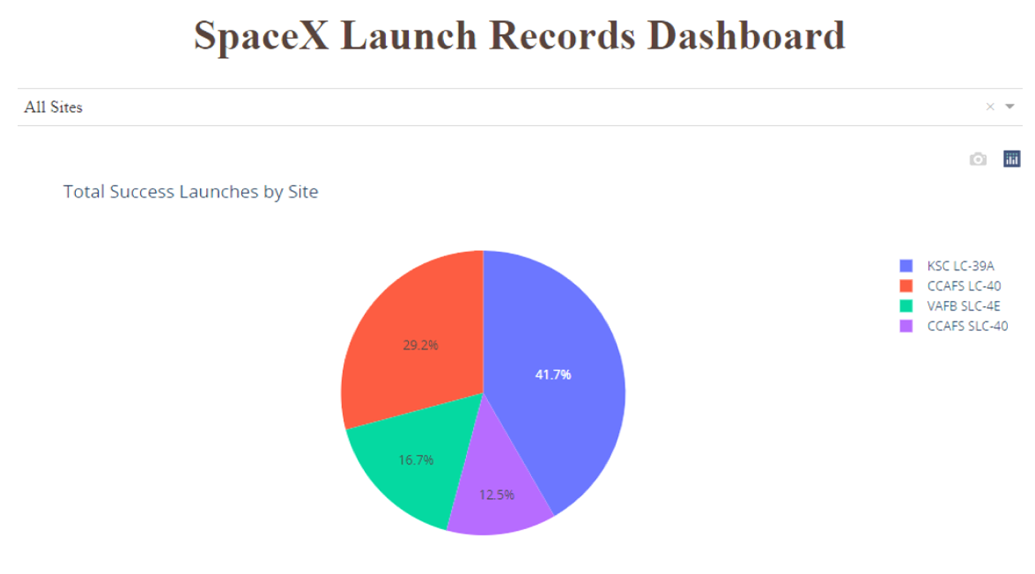
Launch success count for all sites
The graph shows the launch sites, where KSC LC-39 had the most successful launches with a total of 41.7% successful launches.

Slide 40
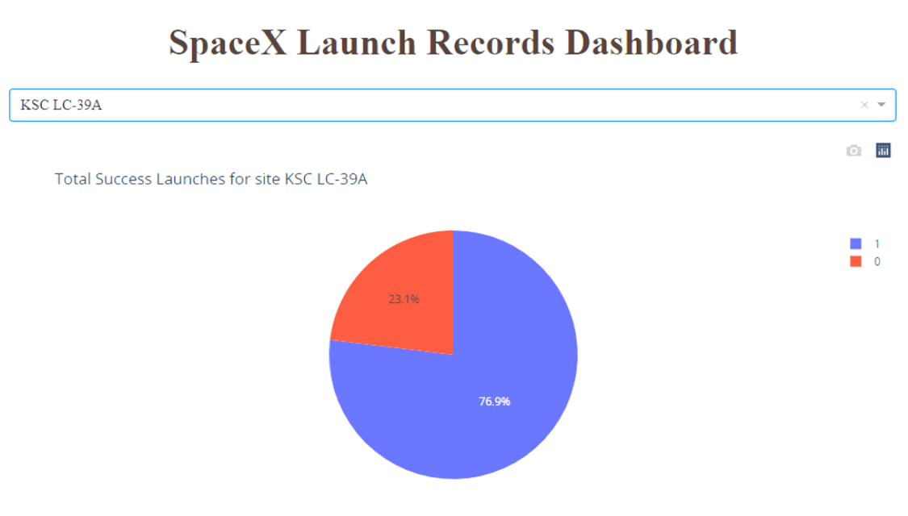
Launch site with highest launch success ratio
The KSC LC-39 A launch site also had the highest rate of successful launches, with a success rate of 76.9%. While its launch failure rate is 23.1%.

Slide 41
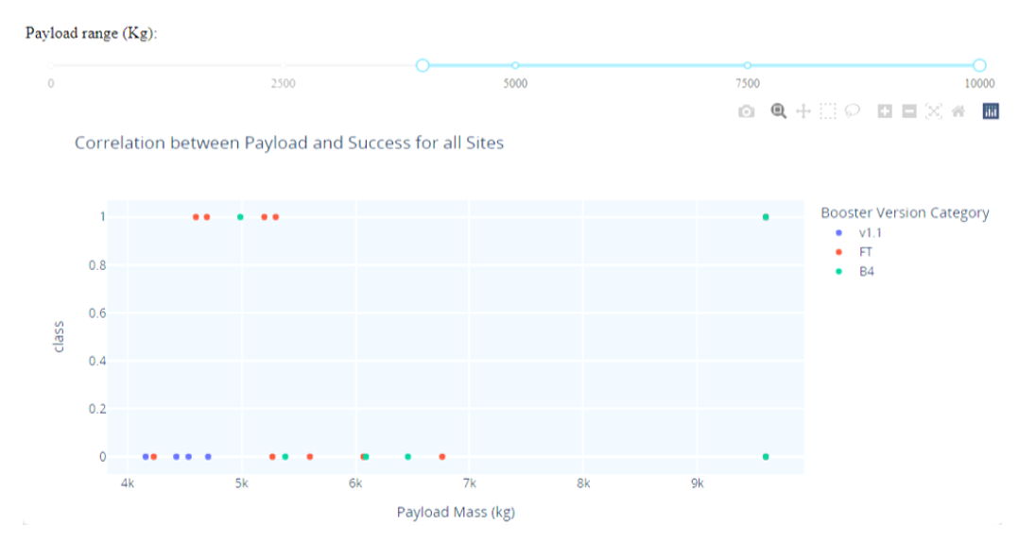
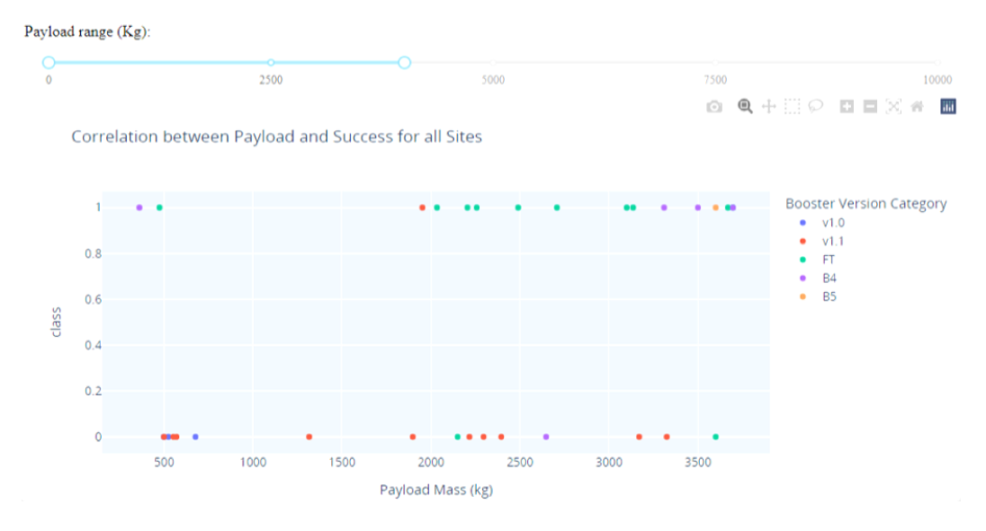
Payload vs. Launch Outcome scatter plot for all sites
The success rates for low weights payloads is higher than the heavy weighted payloads
The booster types v1.0 and B5 have not been launched with massive payloads.

Slide 42

Section 5
Predictive analysis - Classification

Slide 43
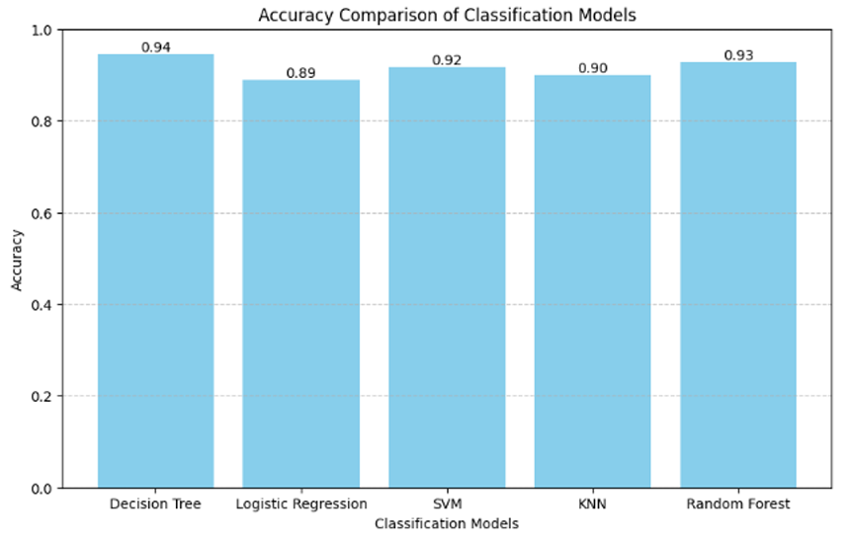
Classification Accuracy
The decision tree is the model with the highest classification accuracy.
The decision tree model achieved the highest classification accuracy with an accuracy score of approximately 94.44%.

Slide 44
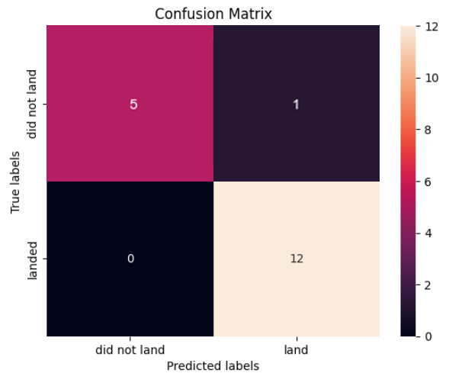
Confusion Matrix
We selected the Decision Tree model as the best performing classifier based on its highest accuracy of approximately 94.44%.
True Positives (TP) = 12 Correctly predicted successful landings.
True Negatives (TN) = 5 Correctly predicted failed landings.
False Positives (FP) = 0 No unsuccessful landings incorrectly predicted as successful.
False Negatives (FN) = 1 One successful landing incorrectly predicted as a failure.
Only one misclassification out of 18 total predictions. No false positives, which means the model is very reliable when predicting success.

Slide 45

Conclusions

Slide 46
Conclusions
📈
🌎
🛰️
Most early flights before 2013 were unsuccessful, but after 2013, success rates steadily increased (despite small dips in 2018 and 2020) Since 2016, there has always been a greater than 50% chance of success.
Orbit types such as ES-L1, GEO, HEO, and SSO achieved a 100% success rate. SSO is the most notable, due to its higher number of launches. And heavy payloads are most successful in orbits such as PO, ISS, and LEO. VLEO launches are associated with heavier payloads.
The launch site KSC LC-39A had the most successful launches with a 41.7% of all successful landings, with a success rate of 76.9%
⚖️
🚀
The success rates for massive payloads of more 4000 kg were lower than for lighter payloads.
The Decision Tree is the best machine learning models and achieved the highest classification accuracy at approximately 94.44%. Is making it the best performing model for predicting Falcon 9 first-stage landing success.

Slide 47
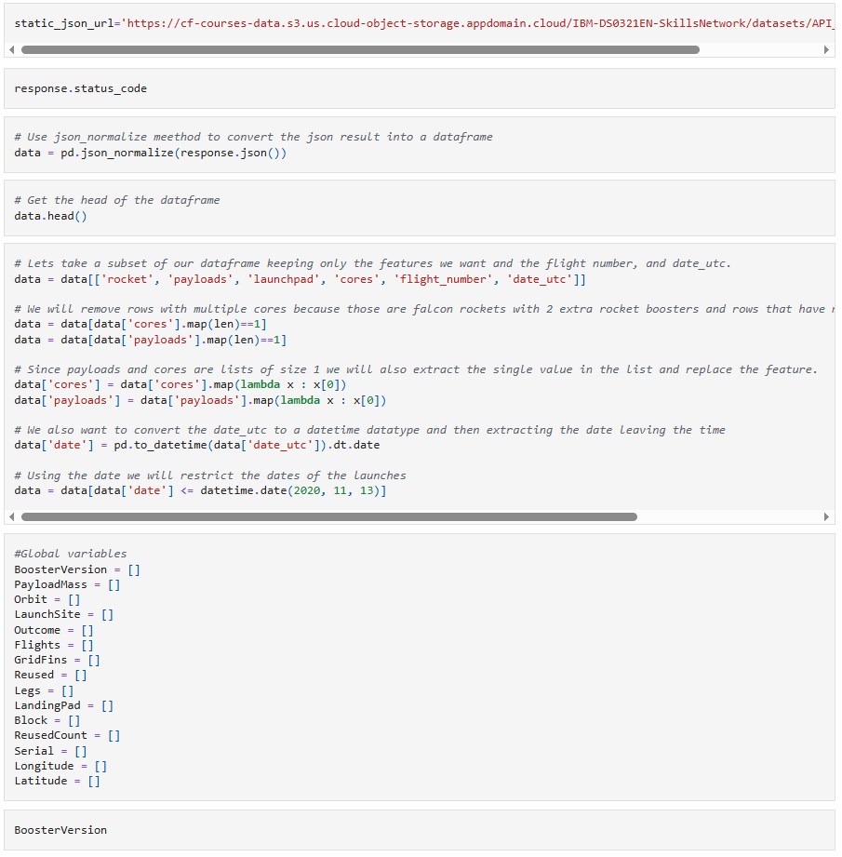
Appendix - API

Slide 48
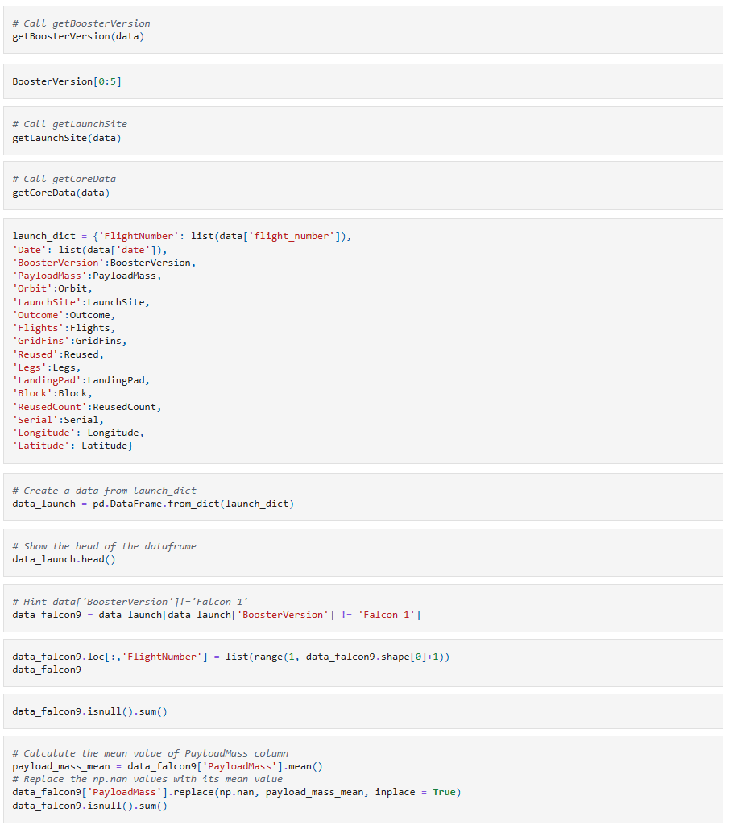
Appendix - API

Slide 49
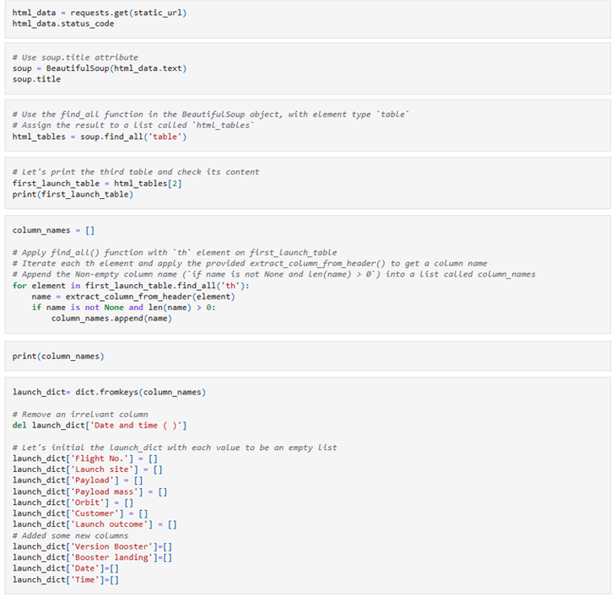
Appendix - WEB SCRAPING

Slide 50
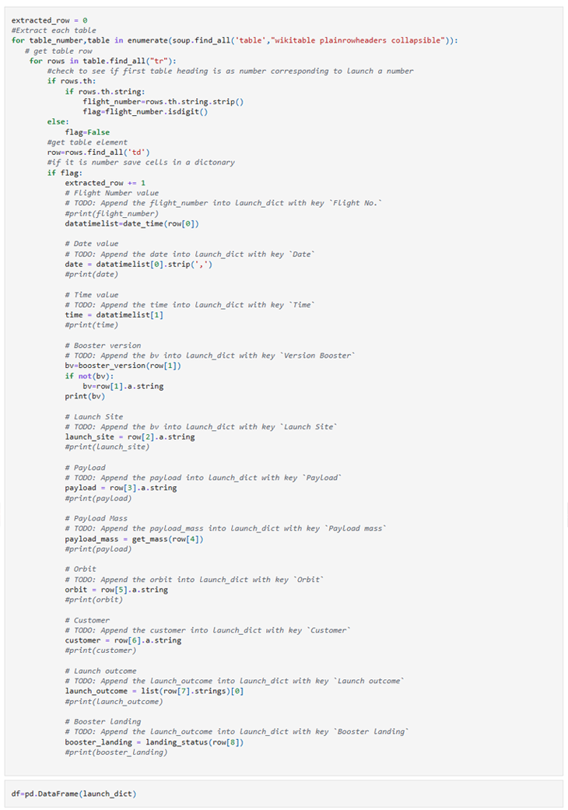
Appendix - WEB SCRAPING

Slide 51
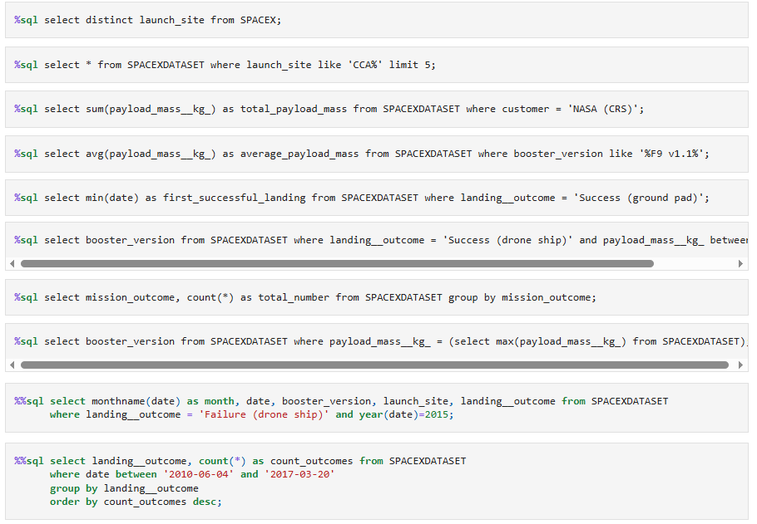
Appendix - SQL

Slide 52
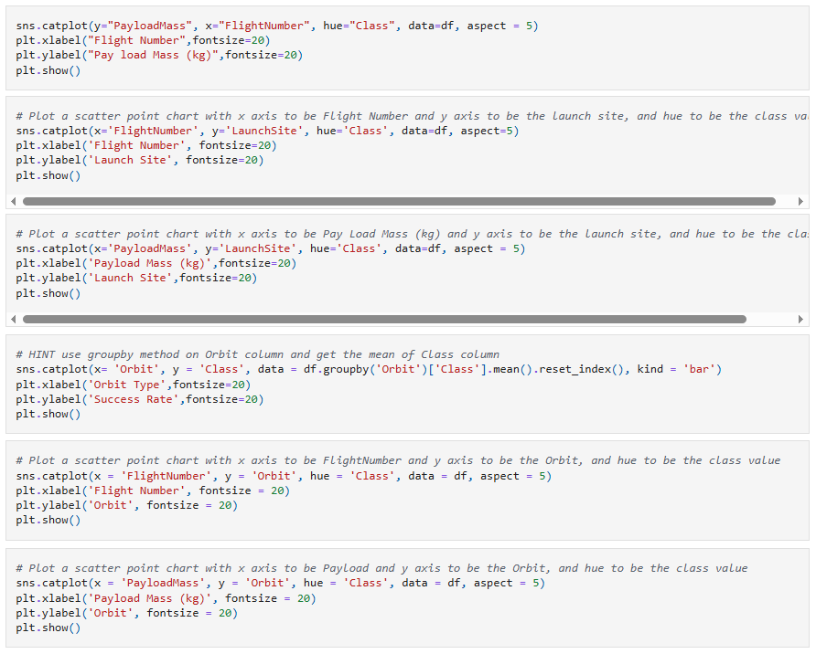
Appendix – EDA Charts

